Slide 1
Interactive Dashboard
File created on: 4/8/25 1:48:18 AM EDT

Slide 2
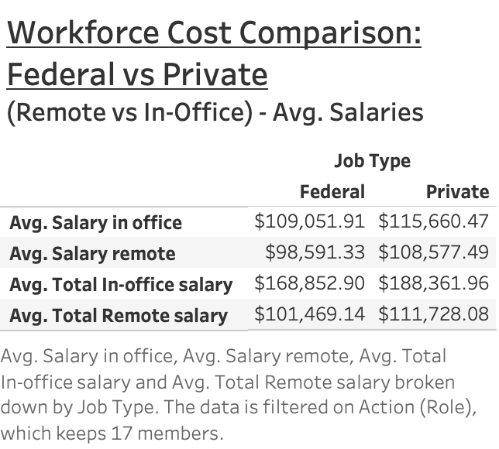

Slide 3
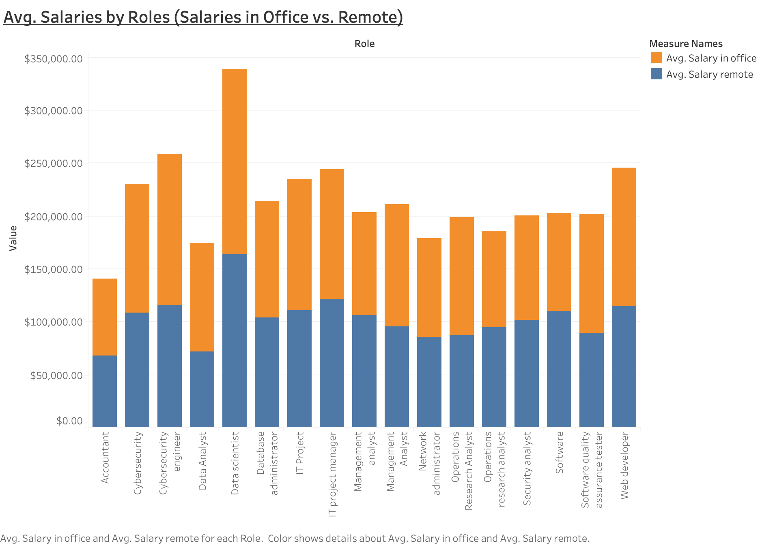

Slide 4
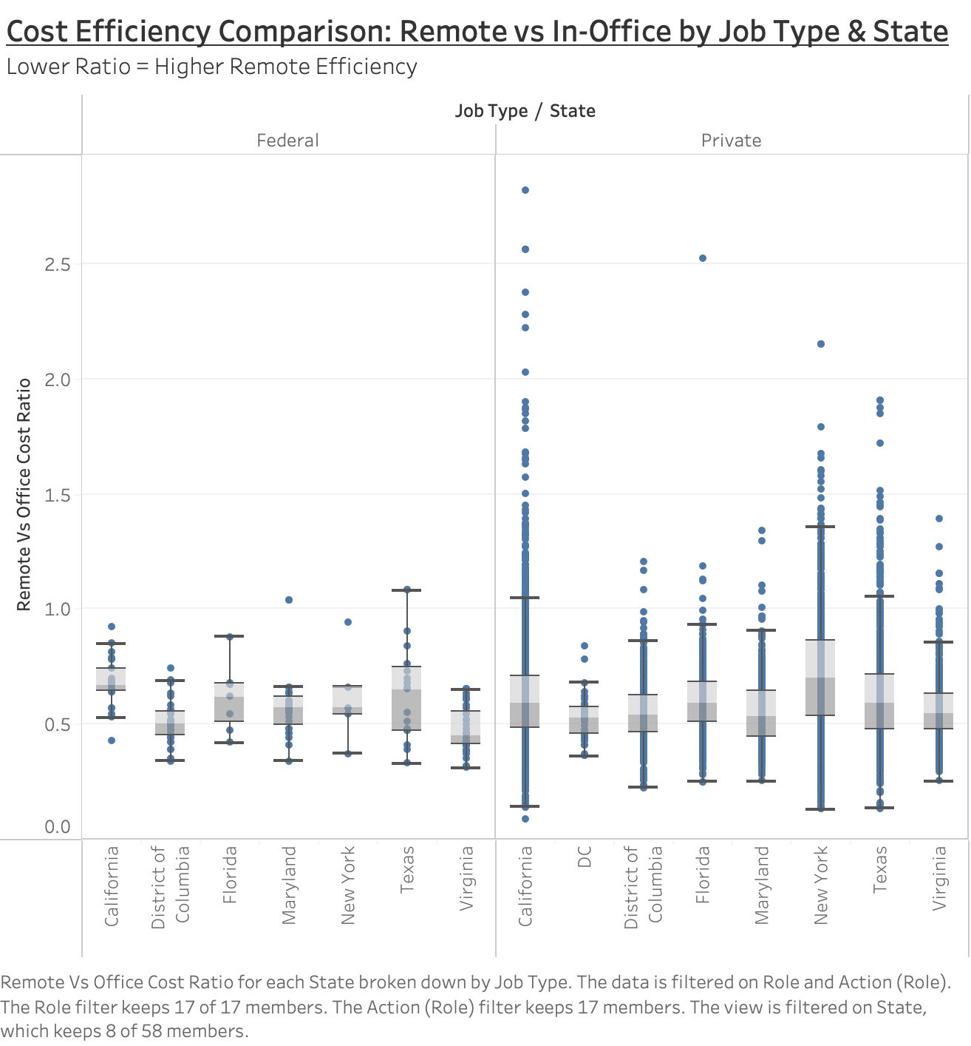

Slide 5
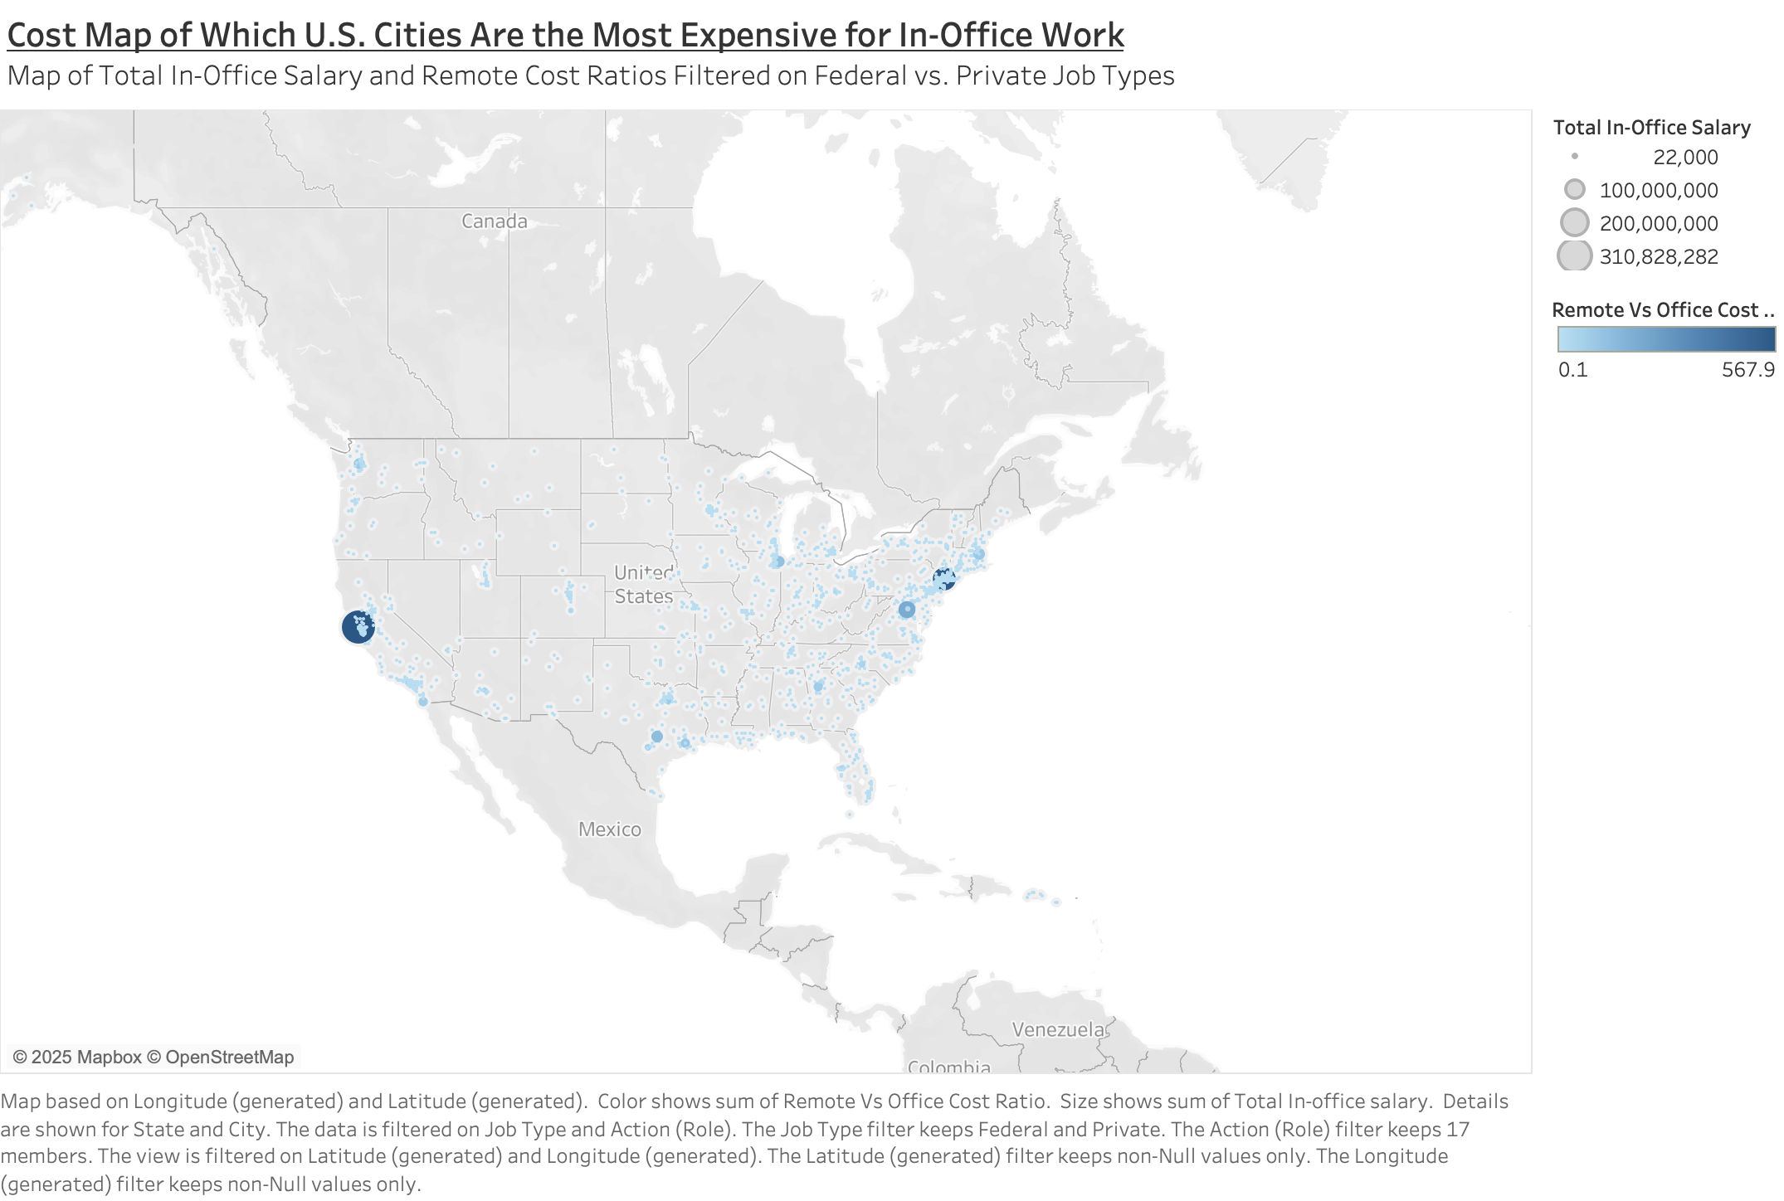

Slide 6
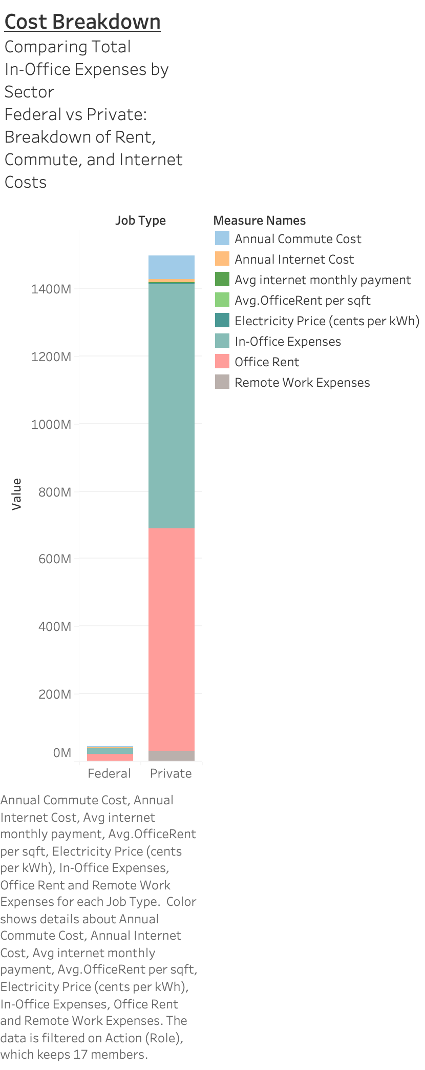

Slide 7
